Slide 1
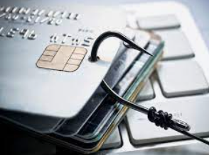
^{Credit Card Fraud Detection}
By: Pratik Chakraborty

Slide 2
Table of Contents
PROBLEM
PROJECT OVERVIEW
ABOUT THE DATA
APPROACH
Cost-Benefit Analysis

Slide 3
PROBLEM
Credit card fraud is commited using a payment card, such as a credit card or debit card by stealing the card information through skimmers.
Credit card companies face MONEY LOSS to $50 billions dollars per year to fraud
The Federal Trade Commission (US) estimates that 10 million people become victims of credit card theft each year

Slide 4

PROJECT OVERVIEW
Finex is a leading financial service provider whose most important business goal is retaining high profitable customers.
There is a large number of unauthorized transactions causing high revenue and profitability crises.
Customers complain about unauthorized transactions, fraudsters use stolen cards and access the personal data of many cardholders
Now, Finex is not equipped with the latest financial technologies, and it is becoming difficult for the bank to track these data breaches on time to prevent further losses.

Slide 5
Problem of Mislabeling
A fraud transaction labelled as normal transaction
Normal transaction is
labelled as fraud
The credit card needs to be replaced and the client reassured and refunded
Transaction order is accepted though it is a fraud
The client credit card gets blocked on unfounded suspicion of fraud
Client was reassured, but the credit card reactivated

Slide 6
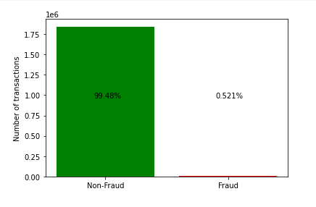
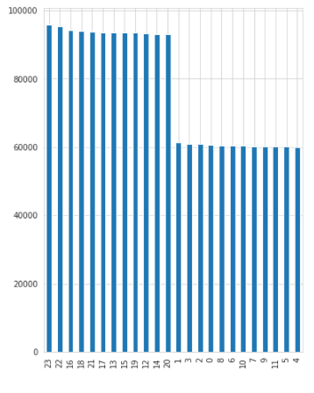
ABOUT THE DATA
The data set contains credit card transactions of around 1,000 cardholders with a pool of 800 merchants from 1 Jan 2019 to 31 Dec 2020.
(1852394, 22) rows and columns
Data is highly imbalanced, there is 99.48% non-fraud transaction and 0.52% Fraud transaction.
It is found that there is higher fraud risk at night and in the morning
There was skewness in the data

Slide 7
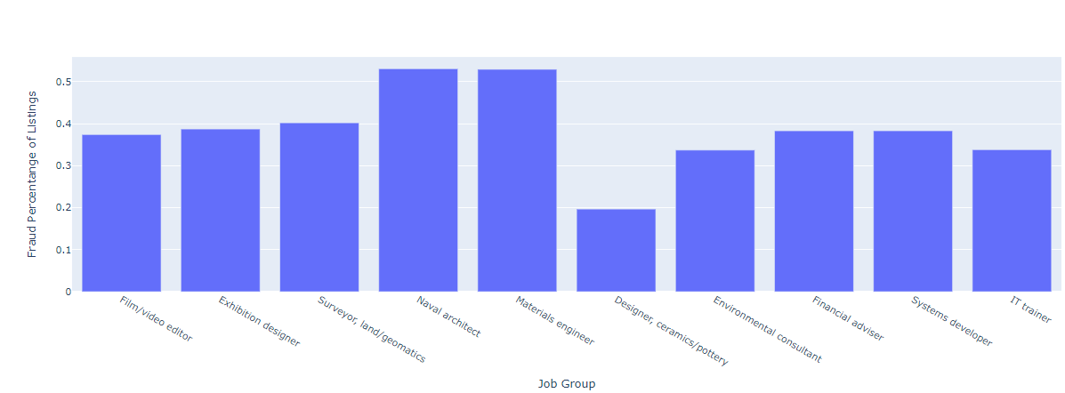
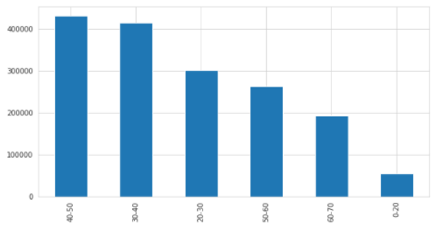
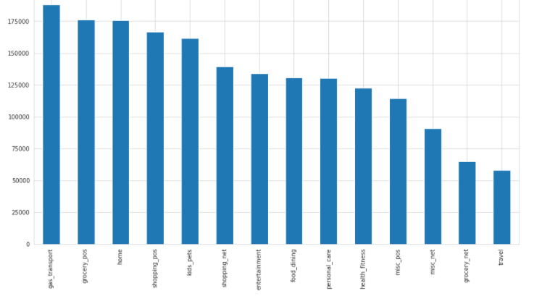
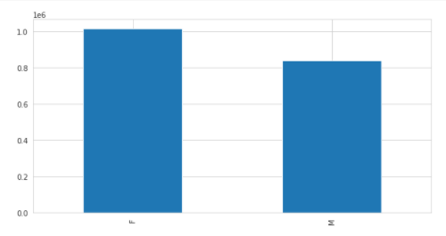
Age group of 40-50 years has the highest number of transaction
Navalarchitect and Materials engineer has the highest percentage of fraud transactions
Job
Age group
Female customers are higher credit card transactions
than male customers
gas_transport has highest number of credit card transactions
Category
Gender

Slide 8
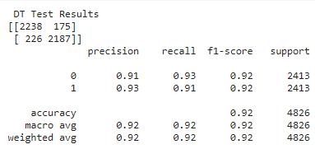
APPROACH
Data was highly imbalanced and the most appropriate sampling technique to handle this was Undersampling.
Used the stratified k-fold cross-validation method with an appropriate k value of 3.
Models used in Model Building was Logistic regression, Decision tree, and Random Forest
It is important to identify which transactions are fraudulent transactions more accurately than identifying non-fraudulent transactions.
An appropriate evaluation metric that reflects this business goal is Precision, Recall, Averageprecision score
RESULTS:
Best auc was 0.982 in Decision tree model

Slide 9
Cost-Benefit Analysis
Average number of transactions per month = 77184
Average number of fraudulent transaction per month= 402
Average amount per fraud transaction= 531
Cost incurred per month before the model was deployed is $2,13,389.00
Cost incurred per month after the model is built and deployed is $5288.402
The final savings that my model can potentially provide to Finex is $2,08,100.60

Slide 10
Thank you

